Slide 1
Campus Odor Policies

Slide 2
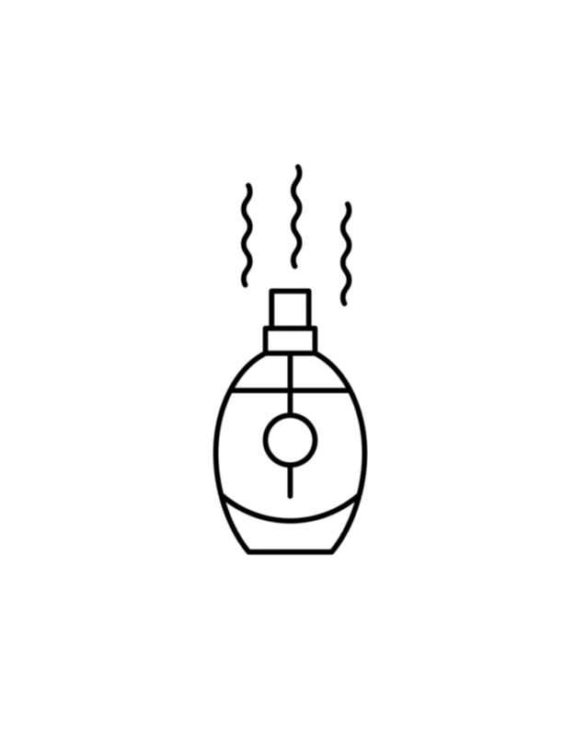
Campus Odor Policies
Online search identified 42 schools and one state school system with odor polices
Of those, 23 Schools and 1 state school system have
cannabis-specific odor policies and 2 schools have policies that link odor to drugs
11 public institutions
14 private institutions
1 Public school system (64 campuses)
Most policies found in:
Housing/Residence Halls Policy
12
18 schools and state school system in states where cannabis is legal
CA, DC, IL, MA, MD, MI, MN, MT, NJ, NY, OH, OR, and WA
7 in states where cannabis is illegal
FL, PA, WI, and VA has legalized but not yet available for sale
Student Code of Conduct
6
Student Rights/Community Standards, Student Life/Handbook, Disciplinary Policy
7

Slide 3
Defining Noxious Odor
A noxious odor is any aroma of such intensity that it becomes apparent to others. Binghamton University
A noxious odor is ANY fragrance or aroma that has such intensity that it can become apparent and disruptive to those around. This may become noxious when the smell emanates too strongly. (i.e., cigarette, marijuana, cigar or pipe, perfume, air fresher or large amounts of dirty laundry)
Bowie State University

Slide 4
Other Odor Examples
Odor: Any aroma of such intensity that it becomes apparent to others is prohibited. Concordia University
Violations of the University Drug policy include, but are not limited to, the following:
...Suspicious odor accompanied by visual confirmation of materials often associated with drug use. Drexel University

Slide 5
Defining Cannabis Odor
Odor of Cannabis: For the purposes of this directive, “odor of cannabis” refers to any odor/smell of cannabis detectable to a CSO by use of their normal perceptual faculties. “Odor of cannabis” may come from any of the following (and from substances not listed), including but not limited to: ​
Cannabis smoke from burned cannabis in a bong, pipe, joint, etc. ​
Cannabis vapor from a vaporizer, vaping device, etc ​
Cannabis tinctures, oils, lotions, or other preparations, etc ​
Cannabis edibles ​
Containers or packaging with cannabis residue Reed College

Slide 6
Policy: Prohibition of Noxious Odors
When a noxious odor can be localized to a particular room, flat, suite or apartment, the resident(s) must correct the matter as directed by Residential Life staff. Binghamton University
When a noxious odor can be localized to a unit and/or bedroom, the student(s) and/or guests of that unit or bedroom may be required to meet with the Student Living or their designee. Florida Polytechnic University
When the source of the noxious odor can be traced to a particular room or the odor is emanating from a person and/or her/his clothing, the occupant(s) of that room or person from whom the odor is emanating may be subject to fines and/or charges through the Student Conduct process. Georgetown University

Slide 7
Policy: Prohibition of Cannabis Odors
Drugs and Other Substances; Drug Paraphernalia: The actual or intended purchase, possession or use of illegal drugs, narcotics, controlled substances or prescription drugs without a prescription is prohibited. The smell of cannabis, when combined with other evidence, may be sufficient information to support a violation of this policy. Brandeis University
Housing staff may investigate for a possible cannabis violation based on reasonable evidence. Evidence of cannabis includes, but is not limited to smell, smoke, seeds, residue, presence of odor, fans, towels near or under doors, open windows, attempts to mask scents, bongs, pipes, clips, and plant cultivation. California State University Chico
Using/consuming drugs or cannabis (regardless of location) and then returning to your residence hall under the influence of, or carrying the smell of, the drug/cannabis is also a violation of the policy. Western Washington University

Slide 8
Model Odor Policy
PURPOSE
This policy aims to maintain a learning and living environment conducive to the well-being, comfort, and academic success of all students, faculty, and staff. The university recognizes the potential for strong, noxious/unpleasant/ offensive odors to disrupt classrooms, residence halls, and other campus spaces.
SCOPE
This policy applies to all students, faculty, staff, and visitors on university property or engaged in university-sanctioned events indoors or outdoors.

Slide 9
Model Language
Defining
Noxious/
Unpleasant/Offensive
Odor
A noxious/offensive/unpleasant odor is any odor that is unreasonably strong and likely to cause significant discomfort or disruption to others within the university environment.

Slide 10
Prohibition of Noxious/Unpleasant/Offensive Odors: The creation or emission of noxious odors that significantly disrupts the learning or living environment of others indoors or outdoors is prohibited. This includes, but is not limited to, odors from:
Cannabis/marijuana
Tobacco
Excessive use of perfumes, incense, or colognes
Cooking or food
Spoiled or decaying substances
Unwashed laundry or personal belongings
Model Policy:
Prohibition
Of Noxious
Odors

Slide 11
Procedures for Confiscating Cannabis
When campus security are commissioned officers: they can confiscate and destroy cannabis found on campus.
When security staff are not commissioned officers:
Staff can train to become special police officers
https://mdsp.maryland.gov/Organization/Pages/CriminalInvestigationBureau/LicensingDivision/ProfessionalLicenses/SpecialPolice.aspx
80 hours of training
Background check
Or…
University can negotiate with local police to confiscate and destroy cannabis found on campus, in compliance with federal law.

Slide 12
THANK YOU!

